Slide 1
Audio Signal Modulation and Reconstruction
Sampling, PAM, Delta Modulation, and SNR Analysis
Presented by: Kartikay Dubey - 22/11/EE/034
Ravi Ranjan Pal - 22/11/EE/042
Under the Guidance of:
Prof. B. Lakshmi Priya
School of Engineering, JNU, New Delhi

Slide 2
Overview of the Project
The project focuses on the processing of an audio signal (your voice) through various sampling and modulation techniques.
Audio Input
Sampling at different rates
PAM
Delta
SNR
Techniques include:
Sampling at different rates.
Pulse Amplitude Modulation (PAM) and Demodulation.
Delta Modulation and Demodulation.
Signal Reconstruction.
Signal-to-Noise Ratio (SNR) Analysis

Slide 3
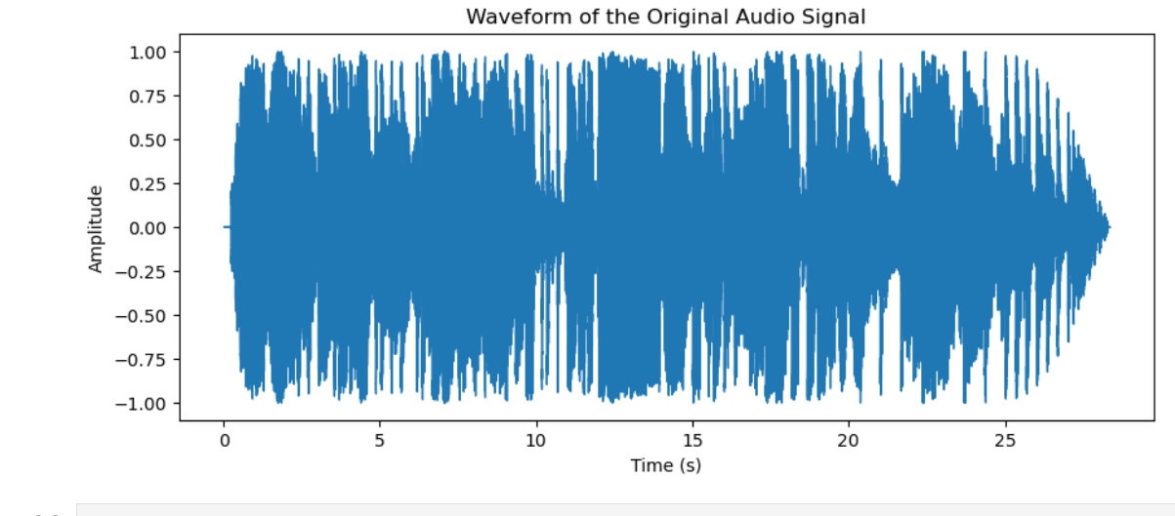
Using Audio Signal as Input
Content:
The input is a pre-recorded voice signal that is processed through various stages.
Key properties of the audio signal:
Sampling Rate: 48 kHz
File Format: .wav

Slide 4
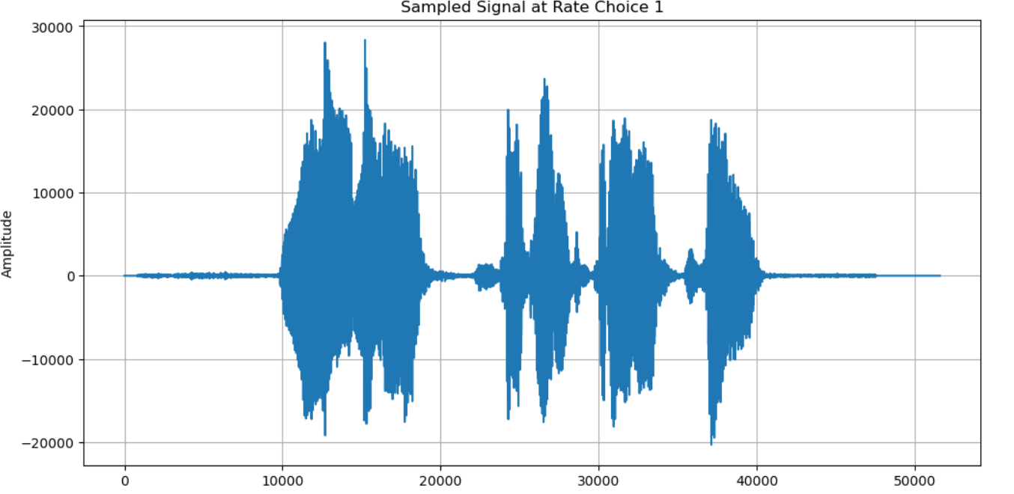
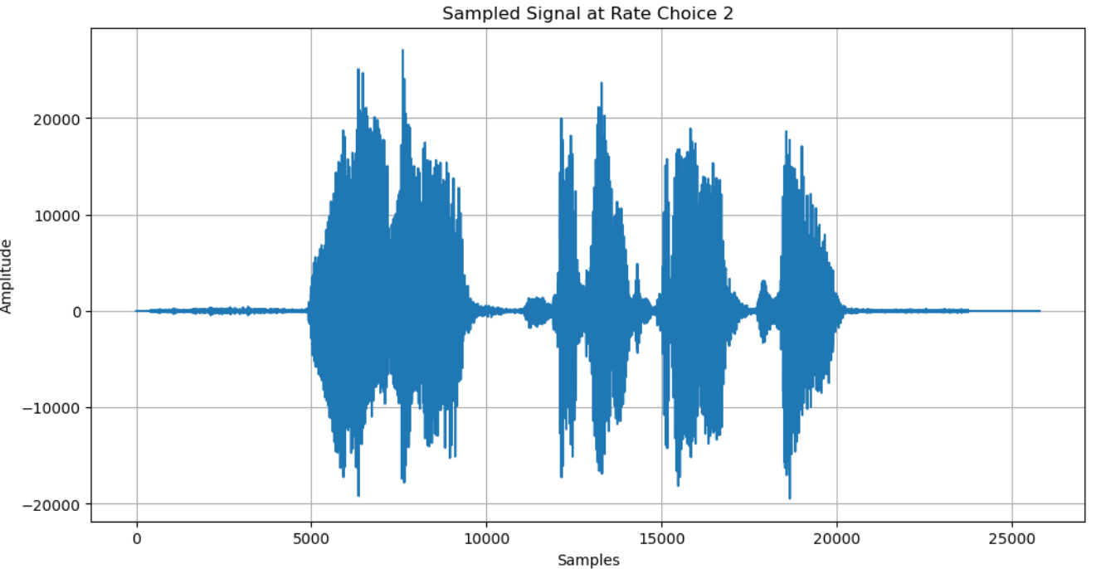
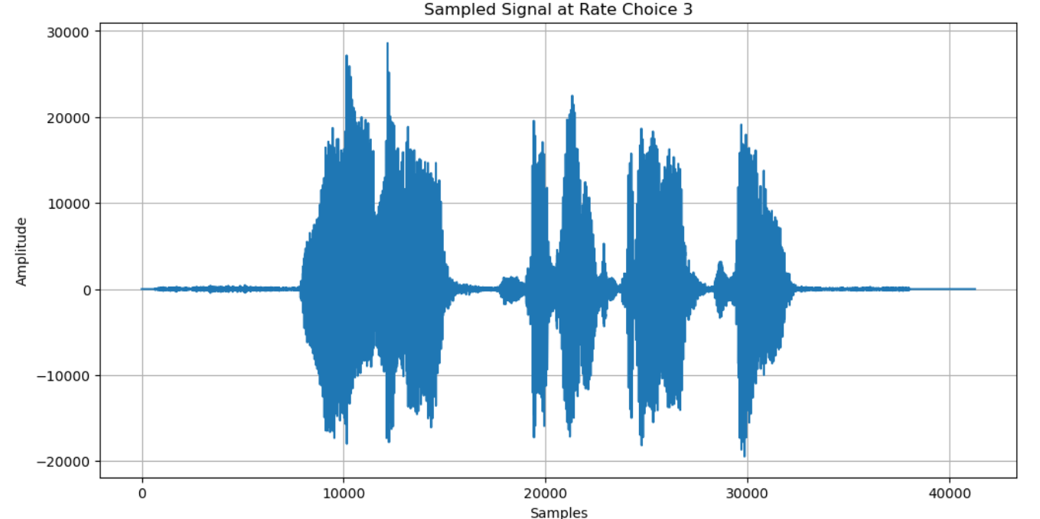
Sampling at Different Rates
Sampling is the process of converting a continuous-time signal (audio) into discrete-time signals at different rates.
Sampling at:
Nyquist rate.
Below Nyquist rate
Above Nyquist rate

Slide 5
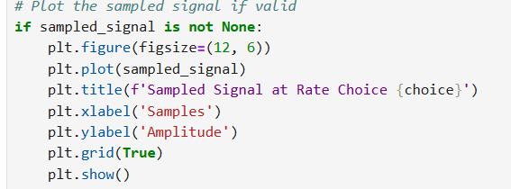
INFERENCES:
Sampling below Nyquist rate can cause aliasing, distorting the signal.
Proper sampling ensures the original signal is retained accurately.

Slide 6
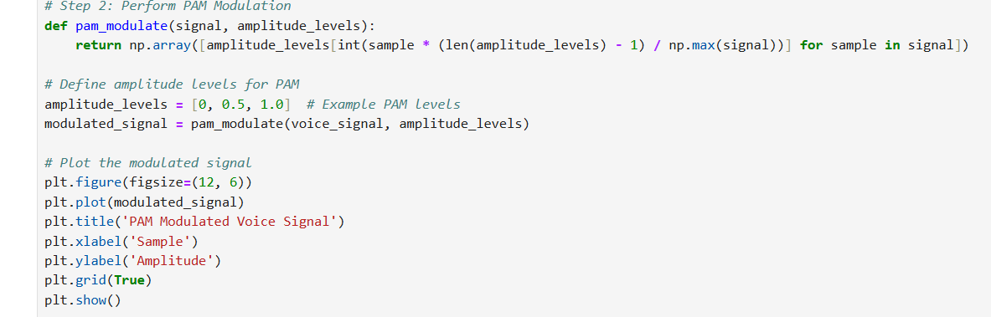
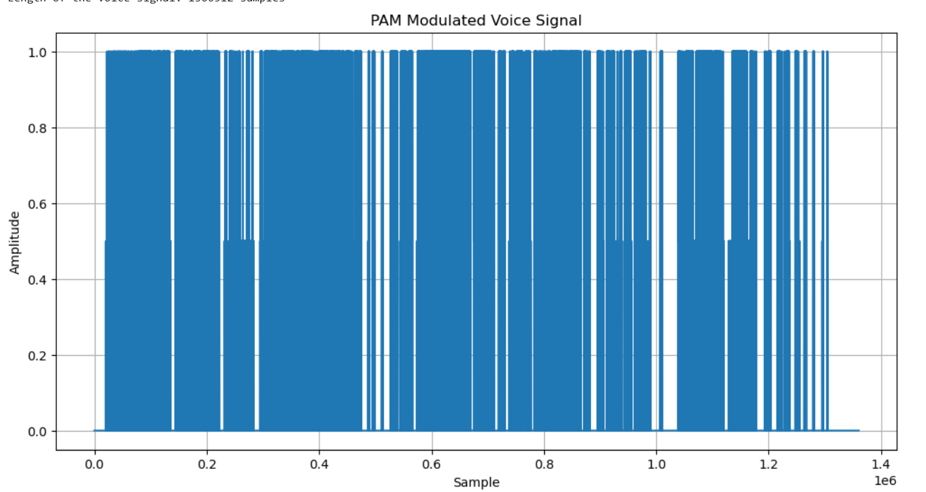
Pulse Amplitude Modulation
PAM is a from of signal modulation where the amplitude of the pulse is varied in accordance with the original signal.
Steps Involved :
Sampling the signal.
Modulating the amplitude of pulses
PAM modulation helps in transmitting analog signals in discrete time, though it may be sensitive to noise.

Slide 7
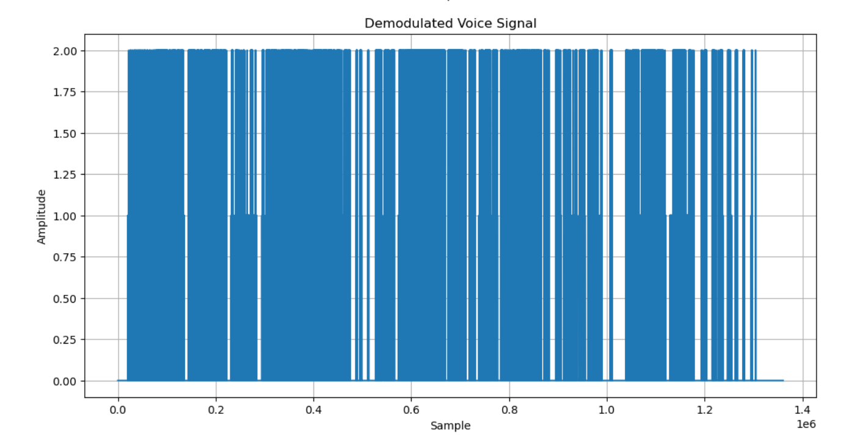
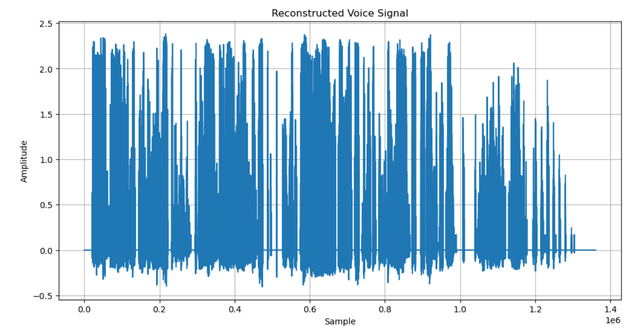
PAM Demodulation and Signal Reconstruction
After modulation, the signal is is demodulated to reconstruct the original signal.
Low-pass filtering is applied to remove high-frequency noise.
Results in a signal that approximates the original audio.
The reconstructed signal closely matches the original signal after demodulation and filtering.
Some distortion/noise may be present, depending on the filter and modulation quality

Slide 8
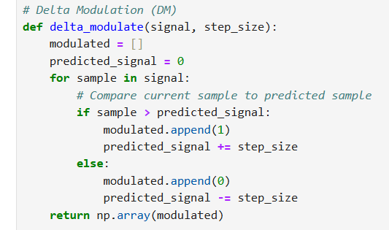
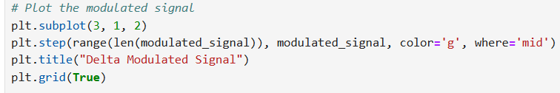
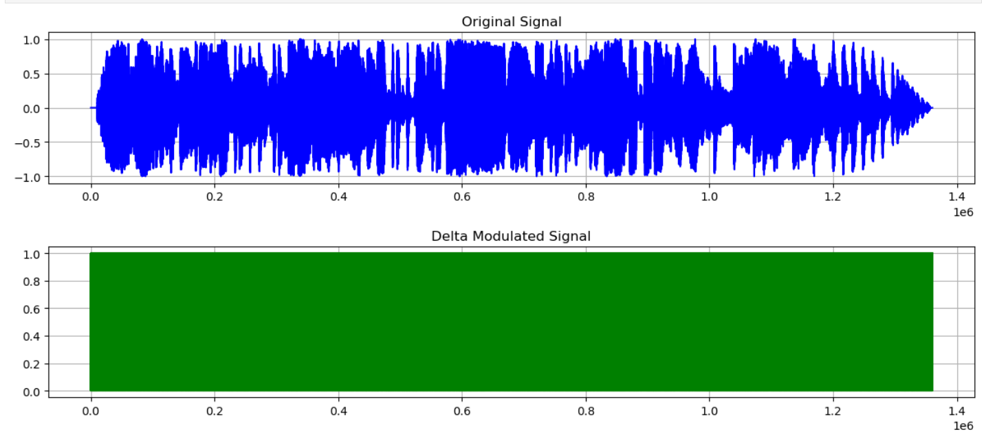
Delta Modulation
Delta modulation is a simpler form of modulation compared to PAM. It approximates the signal by tracking its changes.
Delta modulation encodes the difference between successive samples
Delta modulation is more efficient in terms of data, but might introduce some quantization errors.

Slide 9
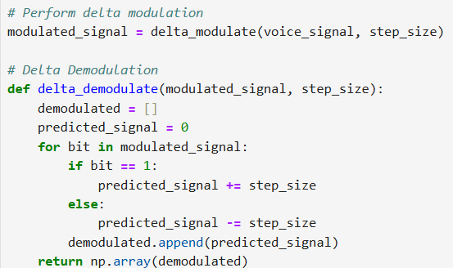
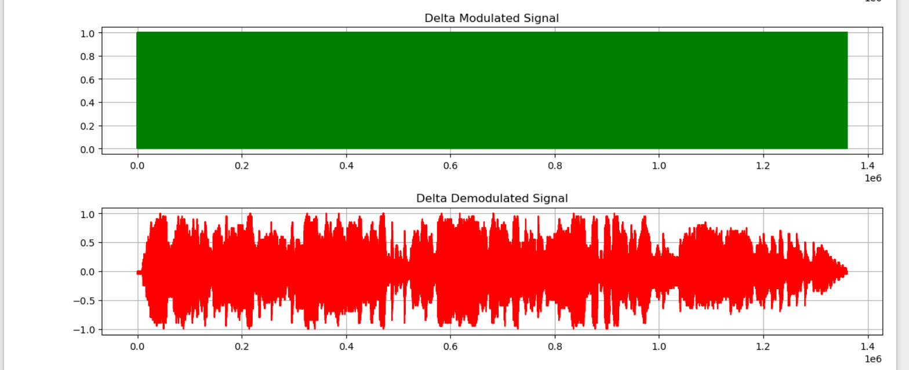
Signal Reconstruction after Delta Demodulation
Demodulating the delta-modulated signal reconstructs the original signal by accumulating the differences.
A low-pass filter is used to smooth out the staircase effect caused by delta modulation.
Delta modulation gives a good approximation of the original signal with lower bandwidth but may introduce more quantization errors compared to PAM.

Slide 10
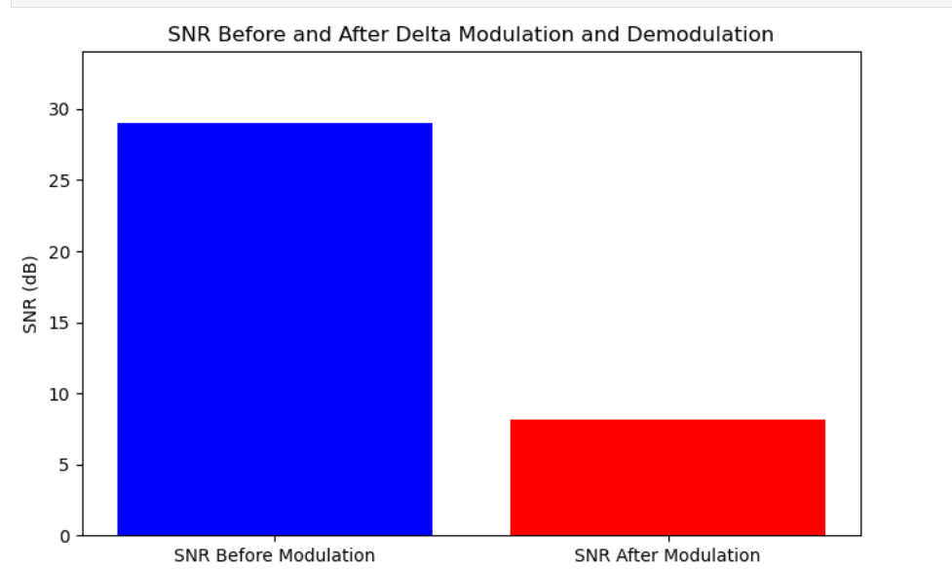
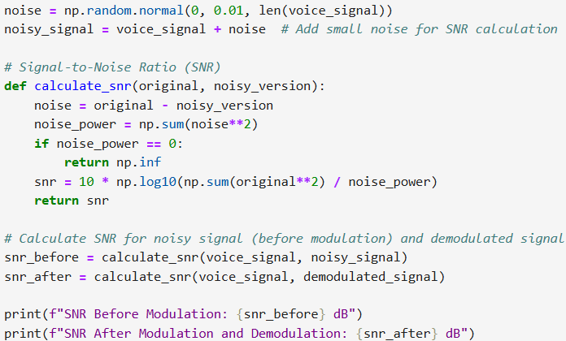
Signal-to-Noise Ratio (SNR) Analysis
SNR is a measure of the signal strength relative to background noise.
After each reconstruction (PAM/Delta Modulation), SNR is computed to assess the quality of the signal. Higher SNR indicates better signal reconstruction quality
Modulation and demodulation techniques introduce noise, but proper filtering improves SNR.

Slide 11
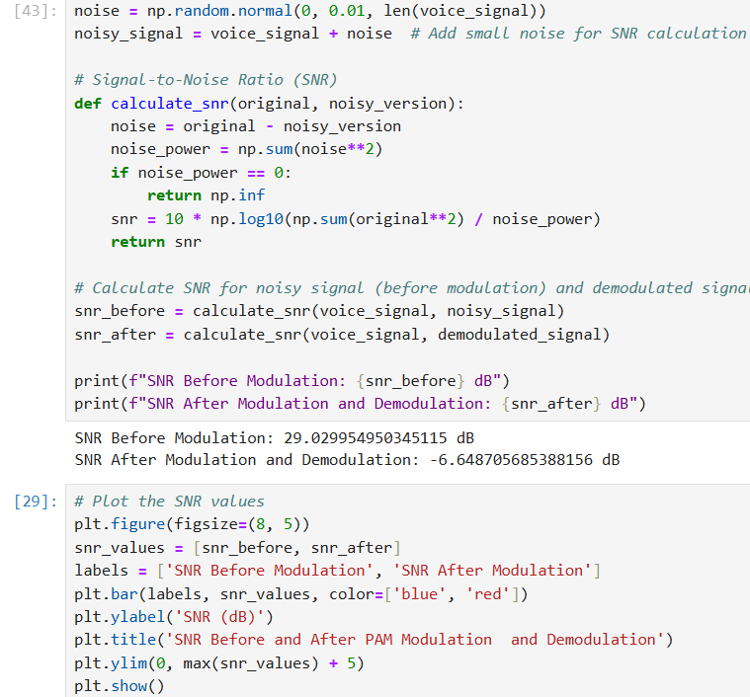
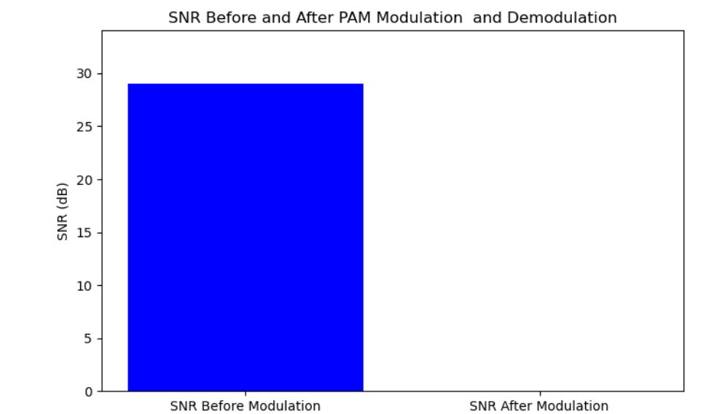

Slide 12
Conclusion
Sampling and modulation techniques like PAM and Delta Modulation are crucial in signal processing.
The quality of reconstruction depends on the modulation technique and the sampling rate.
PAM is more sensitive to noise, but Delta Modulation provides data efficiency at the cost of minor quantization errors.
The SNR helps in quantifying the effectiveness of reconstruction, highlighting the trade-offs between modulation techniques.

